Slide 1
Microservices
UI In A Microservice Architecture

Slide 2

Dozent - Anton Spöck
Co-Founder & CTO innFactory GmbH
Wirtschaftsinformatiker
Fachinformatiker
Cross Platform UIs
React, React-Native
Conversational UIs (Sprach- u. Chatbots)
JavaFX, JavaEE, Android
Für weitere Fragen/Anregungen/Beschimpfungen:
a.spoeck@innFactory.de

Slide 3
Content
The classical approach
The fullstack approach
Comparison
Problems with a Microservice Architecture in a GUI
Styleguides
Latest UI trends

Slide 4
The Monolith
The Developer Team
Frontend
Backend
Database

Slide 5
Front & Back
Frontend Team
Frontend
Backend
Backend / DevOps Team
Database

Slide 6
The classical approach to split UI and Backend
Without Microservice Architecture:
Split the Frontend Developers and the Backend Developers (+ DevOps Engineers) into separate Team
Together with a Microservice Backend:
Also split the team in front- and backend
Horizontal separation of each service in the backend
Specific aggregation for each frontend
→ Developers are specialized and separated for each technology

Slide 7
Microservices
Frontend Team
Frontend
Aggregation Layer
Backend
Product Service
Search Service
Basket Service
Auth Service
Payment Service
Database

Slide 8



Aggregation Layer
Supports an API for each frontend → Backend for Frontend Pattern (BFF)
e.g. REST, GraphQL
Aggregation Layer

Slide 9
The fullstack approach
Full vertical separation
→ Developers are specialized and separated by business cases

Slide 10
FullStack Microservices
Product Team
Search Team
Basket Team
Auth Team
Payment Team
Frontend
Backend
Database
Note: Each service is still splittet into backend and frontend. This graphic should illustrate the team organization.

Slide 11
Comparison
The classical or horizontal approach
State of the art and less risky (from a technological perspective)
Easier to find specialized developers
One team, one user experience
The fullstack or vertical approach
Knowledge transfer in your team (technological)
Flexible developers ( + working fullstack is often engaging for developers)
Pure focus on one service

Slide 12
Problems with a Microservice Architecture in a GUI
Product Team
Search Team
Basket Team
Auth Team
Payment Team
Button1
Frontend
Button1
Button1
The same component is used by several teams.
How to share it?
Versioning?
WebComponents could be the answer for the future!

Slide 13
Problems with a Microservice Architecture in a GUI
Product Team
Search Team
Basket Team
Auth Team
Payment Team
jQuery
React v16
Frontend
EmberJS
Angular 2
React v15
The teams can’t make their own choice for a technology stack or are at least very limited.
In a productively scale it’s almost impossible to combine different frontend frameworks and even different versions of the same framework (even for server side rendering)
The point: In a dynamic gui the pages and components are depending on each other. They’re highly interacting and need context data/states of other parts. But each framework has it’s own solution for flowing state changes.

Slide 14

Styleguides

Slide 15
Styleguides
„A style guide (or manual of style) is a set of standards for the writing and design of documents, either for general use or for a specific publication, organization, or field. (It is often called a style sheet, though that term has other meanings.)” Wikipedia
Benefits
Expandability
Consistency
Collaboration
Examples:
Google Material Design: https://material.io/guidelines/
Starbucks: https://www.starbucks.com/static/reference/styleguide

Slide 16

Styleguides
Atomic Design System
„A mental model to help us think of our user interfaces“ _{~ Brad Frost}

Slide 17
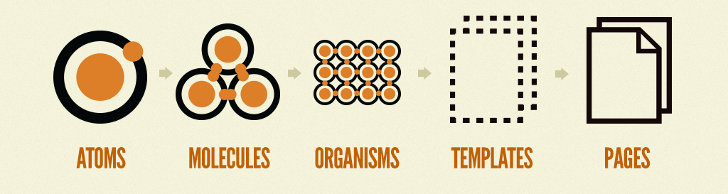
Styleguides
Atomic Design System

Slide 18
Styleguides
Atomic Design System
→ Atoms e.g. Colors, Spacings, Typography…
color-brand: `#DA3743`
hsla
.css
rgba
.json
8 Hex
.xml

Slide 19

Styleguides
Atomic Design System
→ for example a molecule

Slide 20


Latest UI trends
Web: The biggest players

Slide 21

Latest UI trends
Web: The rising star
Vue.js

Slide 22









Latest UI trends
Web: Other frameworks and technologies you should keep in mind

Slide 23
Latest UI trends
Web:
WebComponents (https://www.webcomponents.org/)
Progressive Web Apps (PWA)
→ „Installable“ Websites

